Slide 1
Introduction to Behavior Driven Development
Using Java, JBehave, and Selenium
By Jonathan Salatan
Senior Consultant
Notes:
The objective of TDD is for a developer to gain confidence on his code, not to replace QA. –
http://martinfowler.com/articles/is-tdd-dead/

Slide 2
In a Glance
History
Definition
Process
Demo
Benefits
History
Definition
Process
Benefits
Demo

Slide 3
History of bdd
History
Definition
Process
Benefits
Demo
What existed before BDD?
When did BDD start?
Who authored BDD?
What triggered the creation of BDD?
Notes:
[1] https://www.jfokus.se/jfokus10/preso/jf-10_Behaviour-DrivenDevelopment.pdf

Slide 4
Prior to BDD
Based on a number of studies, around HALF of all software projects fail to deliver in some significant way¹.
 | Standish CHAOS Report (1994 to 2012)
 | Year | Success | Challenged | Failed
 | 1994 | 16% | 53% | 31%
 | 1996 | 27% | 33% | 40%
 | 1998 | 26% | 46% | 28%
 | 2000 | 28% | 49% | 23%
 | 2004 | 29% | 53% | 18%
 | 2006 | 35% | 46% | 19%
 | 2008 | 32% | 44% | 24%
 | 2010 | 37% | 42% | 21%
 | 2012 | 39% | 43% | 18%
Ambysoft Survey (2007 to 2013)
Year | Success | Challenged | Failed
2007 | 60% |  | 40%
2008 | 67% |  | 33%
2010 | 58% | 35% | 14%
2011 | 58% | 33% | 8%
2013 | 59% | 29% | 12%
70 To 80%
40%
Success: The project is completed on-time and on-budget, with all features and functions as initially specified
Challenged: The project is completed and operational but over-budget, over the time estimate, and offers fewer features and functions than originally specified.
Failed: The project is cancelled at some point during the development cycle and/or never used
Notes:
References:
http://www.ambysoft.com/surveys
http://www.versionone.com/assets/img/files/CHAOSManifesto2013.pdf
Resolution Type 1, or project success: The project is completed on-time and on-budget, with all features and
functions as initially specified.
Resolution Type 2, or project challenged: The project is completed and operational but over-budget, over the time
estimate, and offers fewer features and functions than originally specified.
Resolution Type 3, or project impaired: The project is canceled at some point during the development cycle.
Highlights:
-Before BDD, project failure already existed; 80% challenged and failed, 20% success;
Software failure still exists; Only 40% to 60% of projects succeed;
Next/Questions:
What are the common causes of project failures?
Was contributed to the increase in project success? Any specific methodology?
What are the factors that help contribute to project success?
References:
http://www.ambysoft.com/surveys/success2013.html
http://www.drdobbs.com/architecture-and-design/the-non-existent-software-crisis-debunki/240165910
http://www.computer.org/portal/c/document_library/get_file?uuid=984758f1-4f03-4609-afe6-1c2e4df31900&groupId=889147
http://www.versionone.com/assets/img/files/CHAOSManifesto2013.pdf

Slide 5
Causes of Failures²
Can be broadly categorized into:
How to build
What to build
Others
Stakeholder politics
Commercial pressures
Poor reporting of the project's status
Inaccurate estimates of needed resources
Unmanaged risks
Poor communication among customers, developers, and users
Inability to handle the project's complexity
Sloppy development practices
Poor project management
Use of immature technology
Unrealistic or unarticulated project goals
Badly defined system requirements
² IEEE Spectrum publication - Sep. 2, 2005
Notes:
http://spectrum.ieee.org/computing/software/why-software-fails
Unrealistic or unarticulated project goals
Inaccurate estimates of needed resources
Badly defined system requirements
Poor reporting of the project's status
Unmanaged risks
Poor communication among customers, developers, and users
Use of immature technology
Inability to handle the project's complexity
Sloppy development practices
Poor project management
Stakeholder politics
Commercial pressures
http://en.wikipedia.org/wiki/Software_project_management
http://ezinearticles.com/?Causes-Of-Software-Project-Failure&id=453814

Slide 6
Where BDD comes in…
Aims to address software issues by:
Encouraging a process to build the software RIGHT
A process to help discover the RIGHT software
Notes:
Paradigm: the customer doesn’t know what he/she wants
We are here to discover those needs and build the software to address those needs.

Slide 7

Birth of BDD
Authored by Dan North as a thought experiment in 2003
Author of JBehave, the first BDD framework
“I kept coming across the same confusion and misunderstandings…
…Programmers wanted to know where to start, what to test and what not to test, how much to test in one go, what to call their tests, and how to understand why a test fails.”
-- Dan North, “Introducing BDD”
Notes:
http://www.infoq.com/interviews/dan-north-bdd
http://dannorth.net/introducing-bdd/
“…Programmers wanted to know where to start, what to test and what not to test, how much to test in one go, what to call their tests, and how to understand why a test fails.”

Slide 8
What is BDD?
History
Definition
Process
Benefits
Demo
A loose definition from the author
A more formal definition
Notes:
[1] https://www.jfokus.se/jfokus10/preso/jf-10_Behaviour-DrivenDevelopment.pdf

Slide 9
“Behaviour-driven development is about implementing an application by describing its behaviour from the perspective of its stakeholders”
Notes:
[1] https://www.jfokus.se/jfokus10/preso/jf-10_Behaviour-DrivenDevelopment.pdf

Slide 10
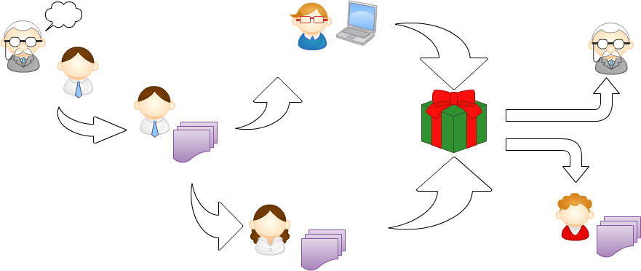
Traditional SW Dev Process
1) The business owner tells the business analyst what he wants
3) The developer translates the requirements into software
2) The business analyst writes a requirements document
4) The tester translates the requirements into test cases
5) The technical writer translates the software into functional and technical documentation
Notes:
http://www.manning.com/smart/BDDinAction_MEAP_CH01.pdf

Slide 11
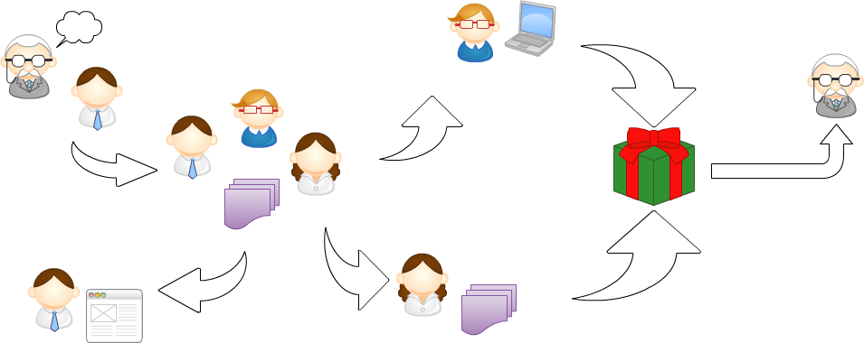
BDD from 50,000 feet
3) The scenarios guide the developer and act as automated tests
1) The business owner tells the business analyst what he wants
2) The business analyst, the developer, and the tester elaborate the requirements together
They define requirements as structured, English-language format “scenarios”
5) The automated tests provide feedback on progress and help document the application
4) The tester uses these scenarios as the basis for her tests
Notes:
http://www.manning.com/smart/BDDinAction_MEAP_CH01.pdf

Slide 12
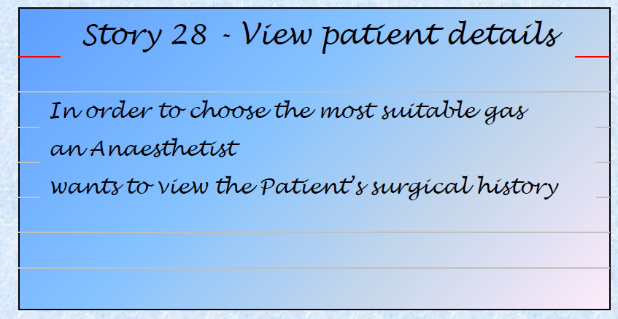
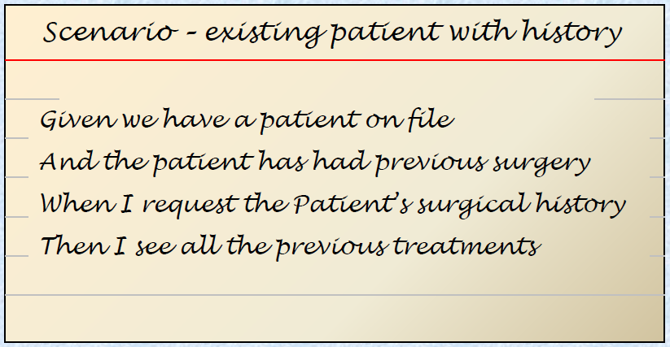
Behaviour from the perspective of its stakeholders
Ubiquitous language;
Gherkin
As a [X] I want [Y] so that [Z]
where Y is some feature, Z is the benefit or value of the feature, and X is the person (or role) who will benefit.
Given some initial context (the givens), When an event occurs, Then ensure some outcomes.
Notes:
http://dannorth.net/introducing-bdd/

Slide 13
Formal definition
“BDD is a second-generation, outside-in, pull-based, multiple-stakeholder, multiple-scale, high-automation, agile methodology.”
Notes:
https://www.jfokus.se/jfokus10/preso/jf-10_Behaviour-DrivenDevelopment.pdf

Slide 14
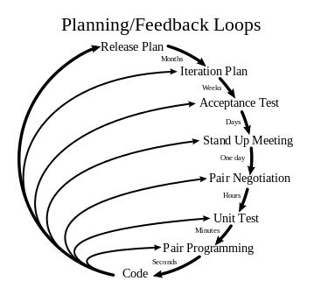

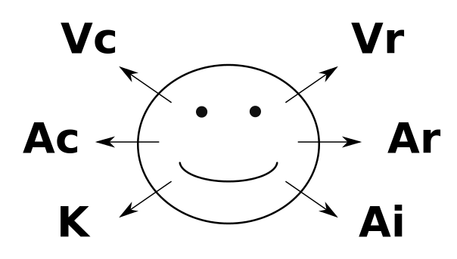
Second generation: derived from and influenced by
BDD
Extreme Programming (XP)
- TDD
- CI
Acceptance Test-Driven Planning
Lean Principles
Domain-Driven Design
- Ubiquitous language
Neurolinguistic Programming (NLP)
Systems Thinking
Notes:
Influenced by Neurolinguistic Programming (NLP)
Visual Construct (Vc)
Visual Recall (Vr)
Auditory Construct (Ac)
Auditory Recall (Ar)
Kinesthetic (K)
Auditory Internal Dialogue (Ai)

Slide 15
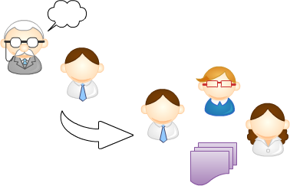
Outside-in
“…behaviour from the perspective of its stakeholders…”
Notes:
“…describing its behaviour from the perspective of its stakeholders…”

Slide 16
High Automation
CI ensures the application is always releasable
Requires comprehensive automated acceptance tests
And that your CI environment is similar to the real one
Notes:
CI and SCM principles apply elsewhere too
You can version your database changes
And automate the roll-forward and roll-back
Some features require on-going monitoring
e.g. Performance testing or penetration testing

Slide 17
What DO WE need to do bdd?
History
Definition
Process
Benefits
Demo
Story/Feature
Scenario
Steps
Notes:
BDD practitioners use conversations around concrete examples of system behavior to help
understand how features will provide value to the business. BDD encourages business analysts,
software developers, and testers to collaborate more closely by enabling them to express
requirements in a more testable way, in a form that both the development team and business
stakeholders can easily understand. BDD tools can help turn these requirements into
automated tests that help guide the developer, verify the feature, and document what the
application does.

Slide 18
“It describes a cycle of interactions with well-defined outputs, resulting in the delivery of working, tested software.”
Notes:
https://www.jfokus.se/jfokus10/preso/jf-10_Behaviour-DrivenDevelopment.pdf

Slide 19
Component 1: Story/Feature

Slide 20
Component 2: Scenario

Slide 21
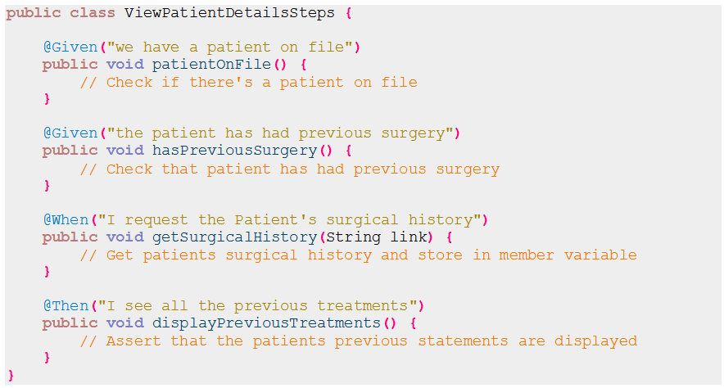
Component 3: Steps

Slide 22
DEMO
History
Definition
Process
Demo
Benefits
Java
JBehave
Selenium
Notes:
Sound familiar?
BDD helps teams focus their efforts on identifying, understanding, and building valuable
features that matter to the business, and it makes sure that these features are well designed
and well implemented.

Slide 23
Story File
Story: Save a form (with field exclusion)
Narrative:
In order to save the current state of an un-submitted form
As a web visitior
I want to be able to save a form
Scenario: User saves a form
Given a user is in the Home page
When the user clicks the 'User Registration' link
Then the 'User Registration' page is shown
When the user inputs the following values in the form:
|First Name|Last Name|Sex|
|Jose|Rizal|Male|
And clicks the 'Save' button
Then the 'saved' alert box should be displayed
Scenario: User saves a form (parameterized)
Given a user is in the Home page
When the user clicks the 'User Registration' link
Then the 'User Registration' page is shown
When the user inputs <firstName>, <lastName>, and <sex>
And clicks the 'Save' button
Then the 'saved' alert box should be displayed
Examples:
|firstName|lastName|sex|
|Jose|Rizal|Male|
|Corazon|Aquino|Female|

Slide 24
Story File
Story: Load a saved form (with field exclusion)
Narrative:
In order to continue from the last state of an un-submitted form
As a web visitior
I want to be able to load a form
Scenario: User loads a saved form
Given the ff. information was previously saved in the 'User Registration' page:
|First Name|Last Name|Sex|
|Jose|Rizal|Male|
And a user is in the Home page
When the user clicks the 'User Registration' link
Then the 'User Registration' page is shown
When the user clicks on the 'Load' button
Then the form should be updated with the following details:
|First Name|Last Name|Sex|
||Rizal|Male|

Slide 25
Steps File
public class DraftAutoSaveSteps {
protected static final String baseUrl = "http://localhost:18080/btmu-simple-app";
private final Selenium selenium;
public DraftAutoSaveSteps(Selenium selenium) {
this.selenium = selenium;
}
@Given("a user is in the Home page")
public void home() throws InterruptedException {
selenium.open(baseUrl + "/home");
// Wait for element's presence
for (int second = 0;; second++) {
if (second >= 60) {
fail("timeout");
}
if (selenium.isElementPresent("//a[@href='user_registration']")) {
break;
}
Thread.sleep(DraftAutoSaveSeleniumConstants.ONE_SECOND);
}
}
…
@When("the user clicks the $link link")
public void clickLink(String link) {
selenium.click("//a[.=" + link + "]");
}
@Then("the 'User Registration' page is shown")
public void userRegistrationIsShown() {
assertEquals("User Registration", selenium.getText("//html/body/h1"));
}
…
}

Slide 26
Embedder to run Stories
public class DraftAutoSaveWebStories extends JUnitStories {
private final Selenium selenium = new DefaultSelenium("10.62.25.128", 4444, "*iexplore", "http://localhost:18080/btmu-simple-app");
private final SeleniumSteps lifecycleSteps = new PerStorySeleniumSteps(selenium);
private final SeleniumContext seleniumContext = new SeleniumContext();
private final CrossReference xref = new CrossReference();
@Override
public Configuration configuration() {
Class<? extends Embeddable> embeddableClass = this.getClass();
Properties viewResources = new Properties();
viewResources.put("decorateNonHtml", "true");
return new SeleniumConfiguration()
.useSelenium(selenium)
.useSeleniumContext(seleniumContext)
.useStepMonitor(new SeleniumStepMonitor(selenium, seleniumContext, new SilentStepMonitor()))
.useStoryLoader(new LoadFromClasspath(embeddableClass))
.useStoryReporterBuilder(new StoryReporterBuilder()
.withCodeLocation(CodeLocations.codeLocationFromClass(embeddableClass))
.withDefaultFormats()
.withViewResources(viewResources)
.withFailureTrace(true).withFailureTraceCompression(true).withCrossReference(xref)
.withFormats(Format.CONSOLE, Format.HTML, Format.XML));
}
@Override
public InjectableStepsFactory stepsFactory() {
return new InstanceStepsFactory(configuration(),
new DraftAutoSaveSteps(selenium),
lifecycleSteps,
new SeleniumScreenshotOnFailure(selenium));
}
@Override
protected List<String> storyPaths() {
return new StoryFinder().findPaths(CodeLocations.codeLocationFromClass(this.getClass()).getFile(),
Arrays.asList("**/save_form.story", "**/load_form.story"), null);
}
}

Slide 27
BENEFITS of BDD
History
Definition
Process
Demo
Benefits
Benefits of TDD + more
Notes:
Sound familiar?
BDD helps teams focus their efforts on identifying, understanding, and building valuable
features that matter to the business, and it makes sure that these features are well designed
and well implemented.

Slide 28
Benefits of BDD
BDD offers more precise guidance on organizing the conversation between developers, testers and domain experts
Notations originating in the BDD approach, in particular the given-when-then canvas, are closer to everyday language and have a shallower learning curve compared to those of tools such as Fit/FitNesse
tools targeting a BDD approach generally afford the automatic generation of technical and end user documentation from BDD "specifications”
Concrete examples of expected system behavior (specification)
Focuses on business value
Encourages prioritization (of features)
Prevent communication gaps – having everyone in the team communicating more often, better, and based on real world examples
Method of documenting the system under test. The feature files become the documentation.
Method of getting teams to discuss Acceptance Criteria; enabler for Acceptance Test Driven Development
Ensures a common language (ubiquitous) for discussing new features
BDD offers more precise guidance on organizing the conversation between developers, testers and domain experts
Notations originating in the BDD approach, in particular the given-when-then canvas, are closer to everyday language and have a shallower learning curve compared to those of tools such as Fit/FitNesse
tools targeting a BDD approach generally afford the automatic generation of technical and end user documentation from BDD "specifications”
Concrete examples of expected system behavior (specification)
Focuses on business value
Encourages prioritization (of features)
Prevent communication gaps – having everyone in the team communicating more often, better, and based on real world examples
Method of documenting the system under test. The feature files become the documentation.
Method of getting teams to discuss Acceptance Criteria; enabler for Acceptance Test Driven Development
Ensures a common language (ubiquitous) for discussing new features
BDD offers more precise guidance on organizing the conversation between developers, testers and domain experts
Notations originating in the BDD approach, in particular the given-when-then canvas, are closer to everyday language and have a shallower learning curve compared to those of tools such as Fit/FitNesse
tools targeting a BDD approach generally afford the automatic generation of technical and end user documentation from BDD "specifications”
Concrete examples of expected system behavior (specification)
Focuses on business value
Encourages prioritization (of features)
Prevent communication gaps – having everyone in the team communicating more often, better, and based on real world examples
Method of documenting the system under test. The feature files become the documentation.
Method of getting teams to discuss Acceptance Criteria; enabler for Acceptance Test Driven Development
Ensures a common language (ubiquitous) for discussing new features
BDD offers more precise guidance on organizing the conversation between developers, testers and domain experts
Notations originating in the BDD approach, in particular the given-when-then canvas, are closer to everyday language and have a shallower learning curve compared to those of tools such as Fit/FitNesse
tools targeting a BDD approach generally afford the automatic generation of technical and end user documentation from BDD "specifications”
Concrete examples of expected system behavior (specification)
BDD offers more precise guidance on organizing the conversation between developers, testers and domain experts
Notations originating in the BDD approach, in particular the given-when-then canvas, are closer to everyday language and have a shallower learning curve compared to those of tools such as Fit/FitNesse
tools targeting a BDD approach generally afford the automatic generation of technical and end user documentation from BDD "specifications”
Concrete examples of expected system behavior (specification)
Focuses on business value
Encourages prioritization (of features)
Prevent communication gaps – having everyone in the team communicating more often, better, and based on real world examples
Method of documenting the system under test. The feature files become the documentation.
Method of getting teams to discuss Acceptance Criteria; enabler for Acceptance Test Driven Development
Ensures a common language (ubiquitous) for discussing new features
BDD offers more precise guidance on organizing the conversation between developers, testers and domain experts
Notations originating in the BDD approach, in particular the given-when-then canvas, are closer to everyday language and have a shallower learning curve compared to those of tools such as Fit/FitNesse
tools targeting a BDD approach generally afford the automatic generation of technical and end user documentation from BDD "specifications”
Concrete examples of expected system behavior (specification)
Focuses on business value
Encourages prioritization (of features)
Prevent communication gaps – having everyone in the team communicating more often, better, and based on real world examples
Method of documenting the system under test. The feature files become the documentation.
Method of getting teams to discuss Acceptance Criteria; enabler for Acceptance Test Driven Development
Ensures a common language (ubiquitous) for discussing new features
BDD offers more precise guidance on organizing the conversation between developers, testers and domain experts
Notations originating in the BDD approach, in particular the given-when-then canvas, are closer to everyday language and have a shallower learning curve compared to those of tools such as Fit/FitNesse
tools targeting a BDD approach generally afford the automatic generation of technical and end user documentation from BDD "specifications”
Concrete examples of expected system behavior (specification)
Focuses on business value
Encourages prioritization (of features)
Prevent communication gaps – having everyone in the team communicating more often, better, and based on real world examples
Notes:
http://guide.agilealliance.org/guide/bdd.html
http://www.thoughtworks.com/insights/blog/3-misconceptions-about-bdd
http://www.testingthewaterhouse.com/2014/03/benefits-of-using-bdd.html

Slide 29
Benefits of Having Tests
What’s the benefit of adopting or having a TDD approach?
“Having tests allows us to change the software when we need to.
… Testing allow us to make those changes and make sure we haven't broken anything.”
- Aslak Hellesoy,
Creator of Cucumber framework
Notes:
Components of Successful Projects:
What’s the benefit of adopting or having a TDD approach?
“Having tests allows us to change the software when we need to.”
“I don’t want to write tests.”
“We’ve got testers to write tests.”
“I am too important to write tests.”

Slide 30
Benefits of BDD
Confidence in our code (derived from TDD)
Ubiquitous language – a shared language across multiple stakeholders (derived from DDD)
Ensures the application is always releasable (derived from CI)
Documented acceptance tests
Specification by example
Promotes collaboration and agreement between QAs, BAs, and Devs

Slide 31
Pros and Cons of BDD
BDD offers more precise guidance on organizing the conversation between developers, testers and domain experts
Notations originating in the BDD approach, in particular the given-when-then canvas, are closer to everyday language and have a shallower learning curve compared to those of tools such as Fit/FitNesse
Tools targeting a BDD approach generally afford the automatic generation of technical and end user documentation from BDD "specifications”
Concrete examples of expected system behavior (specification)
Focuses on business value
Encourages prioritization (of features)
Prevent communication gaps – having everyone in the team communicating more often, better, and based on real world examples
Method of documenting the system under test. The feature files become the documentation.
Method of getting teams to discuss Acceptance Criteria; enabler for Acceptance Test Driven Development
Ensures a common language (ubiquitous) for discussing new features
Notes:
http://guide.agilealliance.org/guide/bdd.html
http://www.thoughtworks.com/insights/blog/3-misconceptions-about-bdd
http://www.testingthewaterhouse.com/2014/03/benefits-of-using-bdd.html

Slide 32
References
http://dannorth.net/introducing-bdd/
http://behaviour-driven.org
http://en.wikipedia.org/wiki/Behavior-driven_development
http://blog.daveastels.com.s3-website-us-west-2.amazonaws.com/files/BDD_Intro.pdf
http://www.infoq.com/interviews/dan-north-bdd
https://www.jfokus.se/jfokus10/preso/jf-10_Behaviour-DrivenDevelopment.pdf

